Slide 1
Day 2 - Contents
Commands:
Df, fdisk, sfdisk, cfdisk, lsblk, blkid, mdadm
File Editors – vim & nano
Introduction to SSH (Credentials / Private key)
Introduction to Data Evolution
Introduction to Big data

Slide 2
Commands
1. fdisk
Hard disks can be divided into one or more logical disks called partitions. This division is described in the partition table found in sector 0 of the disk.
fdisk - Partition table manipulator for Linux
Syntax:
fdisk [-uc] [-b sectorsize] [-C cyls] [-H heads] [-S sects] device
fdisk -l [-u] [device...]
fdisk -s partition...
fdisk -v
fdisk -h

Slide 3
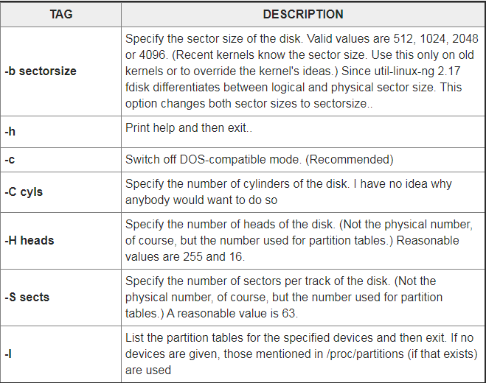
Options

Slide 4
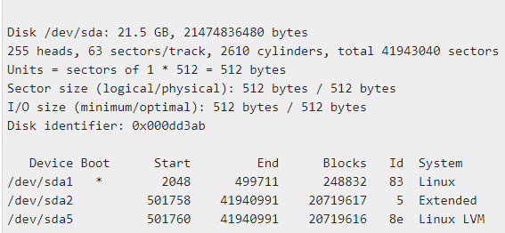
Example:
To view all partitions of specific hard disk use the option ‘-l‘ with device name.
# fdisk -l /dev/sda
output:

Slide 5
2.Df
df (abbreviation for disk free) is a standard Unix command used to display the amount of available disk space for file systems on which the invoking user has appropriate read access.
df is typically implemented using the statfs or statvfs system calls.
The Single UNIX Specification specifications for df are:
df [-k] [-P|-t] [-del] [file...]
-kUse 1024-byte units, instead of the default 512-byte units, when writing space figures.
-PUse a standard, portable, output format
-hDisplay in more easily human readable units such as KB, MB, GB or TB.
fileWrite the amount of free space of the file system containing the specified file

Slide 6
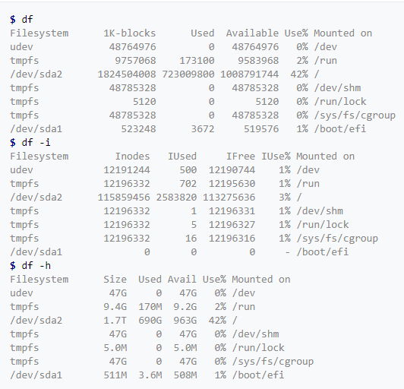
Example:

Slide 7
3. sfdisk
Partition table manipulator for Linux
sfdisk has four (main) uses: list the size of a partition, list the partitions on a device, check the partitions on a device, and - very dangerous - repartition a device.
sfdisk doesn’t understand GUID Partition Table (GPT) and it is not designed for large partitions.
Syntax:
sfdisk [options] device sfdisk -s [partition]

Slide 8
1.List Sizes
sfdisk -s partition gives the size of partition in blocks. This may be useful in connection with programs like mkswap or so.
2. List Partitions
The second type of invocation: sfdisk -l [options] device will list the partitions on this device.
3. Check partitions
The third type of invocation: sfdisk -V device will apply various consistency checks to the partition tables on device. It prints 'OK' or complains. The -V option can be used together with -l. In a shell script one might use sfdisk -V -q device which only returns a status.
4. Create partitions
The fourth type of invocation: sfdisk device will cause sfdisk to read the specification for the desired partitioning of device from its standard input, and then to change the partition tables on that disk. Thus, it is possible to use sfdisk from a shell script.

Slide 9
4. Cfdisk
cfdisk command is used to create, delete, and modify partitions on a disk device.
It displays or manipulates the disk partition table by providing a text-based “graphical” interface.
cfdisk /dev/sda
Options:
-h, –help: It displays help text and exit.
-L, –color[=when]: Colorize the output. The optional argument when can be auto, never or always. If the when argument is omitted, it defaults to auto.
-V, –version: Display version information and exit.
-z, –zero: Start with an in-memory zeroed partition table. This option allows you to create a new partition table from scratch or from a sfdisk-compatible script.

Slide 10
Other command line commands:
While using cfdisk you can use simple commands just like we use in vi editor for saving, inserting etc. The list of commands are as follows:
b: Toggle bootable flag of the current partition. It allows the user to select which partition is primary in the bootable drive. Just press b to see the results, no need of using ctrl.
d: It will will delete the current marked partition, making a free space for new partition.
h: Will print the help screen, showing commands used .
n: Will create a new partition of the marked free space .
q: Will quit the program without writing partitions to the table.
s: Will fix the partitions order if they are now in proper array.
t: Will allow you to change the partition type, allowing you to select from the list.
u: Will dump the disk layout in a specified script file name

Slide 11
W: Will allow the user to write the data to the disk. The user will be asked if he or she wants to write or not by simply taking input “yes” or “no”.
x: Will allow the user to hide or display all extra information of the partition.
Up-Arrow: Will allow the user to move the cursor to the previous partition, like moving up in the given table list.
Down-Arrow: This option allows the user to move the cursor to the next partition, next partition because every new partition is placed after the previous partition.
Left-Arrow: This option allows the user to enter previous menu item.
Right-Arrow: This option allows the user to enter to the next menu item.

Slide 12
5. Lsblk
lsblk lists information about all available or the specified block devices.
The lsblk command reads the sysfs filesystem and udev db to gather information.
If the udev db is not available or lsblk is compiled without udev support, then it tries to read LABELs, UUIDs and filesystem types from the block device.
In this case root permissions are necessary.
Syntax:
lsblk [options] [device...]

Slide 13
OPTIONS
-a, --all Also list empty devices and RAM disk devices.
-b, --bytes Print the SIZE column in bytes rather than in a human- readable format.
-D, --discard Print information about the discarding capabilities (TRIM, UNMAP) for each device.
-d, --nodeps Do not print holder devices or slaves. For example, lsblk --nodeps /dev/sda prints information about the sda device only.
-E, --dedup column Use column as a de-duplication key to de-duplicate output tree. If the key is not available for the device, or the device is a partition and parental whole-disk device provides the same key than the device is always printed.

Slide 14
-e, --exclude list Exclude the devices specified by the comma-separated list of major device numbers.
Note that RAM disks (major=1) are excluded by default if --all is not specified.
The filter is applied to the top-level devices only. This may be confusing for --list output format where hierarchy of the devices is not obvious.
f, --fs Output info about filesystems. This option is equivalent to -o NAME,FSTYPE,FSVER,LABEL,UUID,FSAVAIL,FSUSE%,MOUNTPOINTS.
-h, --help Display help text and exit.
-I, --include list Include devices specified by the comma-separated list of major device numbers.
The filter is applied to the top- level devices only. This may be confusing for --list output format where hierarchy of the devices is not obvious.

Slide 15
-i, --ascii Use ASCII characters for tree formatting
-J, --json Use JSON output format. It's strongly recommended to use --output and also --tree if necessary.
-l, --list Produce output in the form of a list. The output does not provide information about relationships between devices and since version 2.34 every device is printed only once if --pairs or --raw not specified (the parsable outputs are maintained in backwardly compatible way).
-M, --merge Group parents of sub-trees to provide more readable output for RAIDs and Multi-path devices. The tree-like output is required.
-m, --perms Output info about device owner, group and mode. This option is equivalent to -o NAME,SIZE,OWNER,GROUP,MODE.

Slide 16
-n, --noheadings Do not print a header line.
-o, --output list Specify which output columns to print. Use --help to get a list of all supported columns.
The columns may affect tree-like output.
The default is to use tree for the column 'NAME' (see also --tree).
-O, --output-all Output all available columns.
-P, --pairs Produce output in the form of key="value" pairs. The output lines are still ordered by dependencies.
-p, --paths Print full device paths.

Slide 17
5. Blkid
blkid - command-line utility to locate/print block device attributes
Syntax:
blkid [ -hlv ] [ [ -c cachefile ] -w writecachefile ] [ -o format ] [ -s tag ] [ -t NAME=value ] [ device ... ]
Description:
The blkid program is the command-line interface to working with libuuid library.
It can determine the type of content a block device holds, and also attributes (tokens, NAME=value pairs) from the content metadata (e.g. LABEL or UUID fields)
blkid has two main forms of operation: either searching for a device with a specific NAME=value pair, or displaying NAME=value pairs for one or more devices.

Slide 18
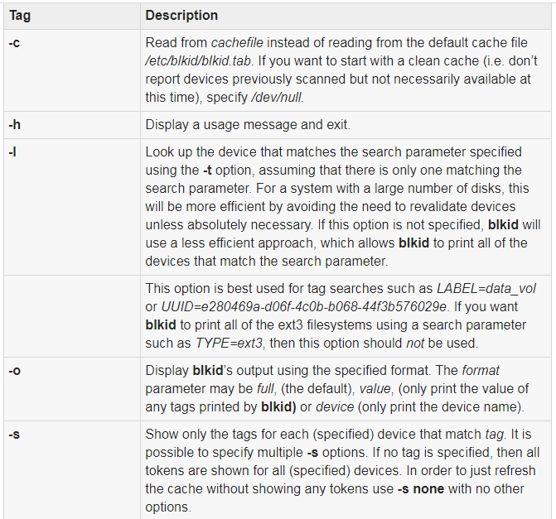

Slide 19
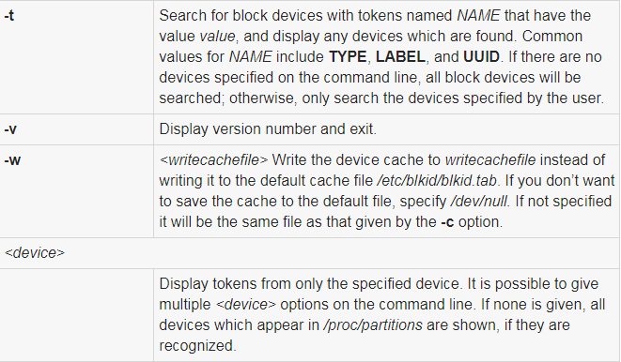

Slide 20
6. mdadm
Manage MD devices aka Linux Software RAID
RAID devices are virtual devices created from two or more real block devices. This allows multiple devices (typically disk drives or partitions thereof) to be combined into a single device to hold (for example) a single filesystem.
Some RAID levels include redundancy and so can survive some degree of device failure.Linux Software RAID devices are implemented through the md (Multiple Devices) device driver.
MULTIPATH is not a Software RAID mechanism, but does involve multiple devices: each device is a path to one common physical storage device.
FAULTY is also not true RAID, and it only involves one device. It provides a layer over a true device that can be used to inject faults.
Syntax:
mdadm [mode] <raiddevice> [options] <component-devices>

Slide 21
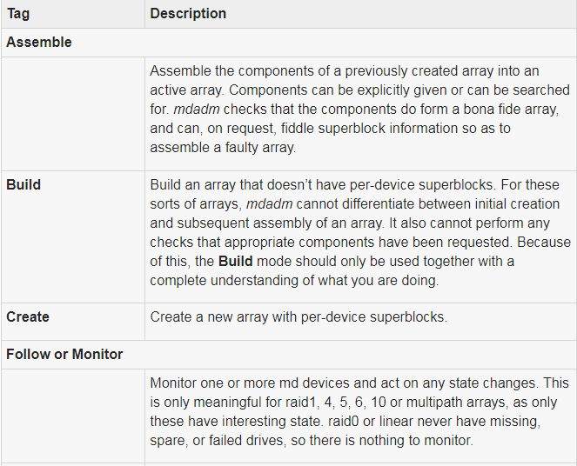
MODES
mdadm has several major modes of operation:

Slide 22
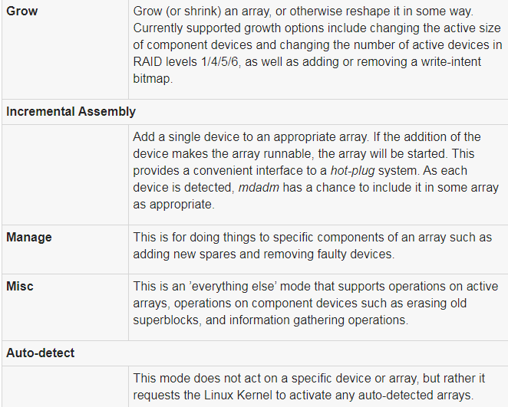

Slide 23
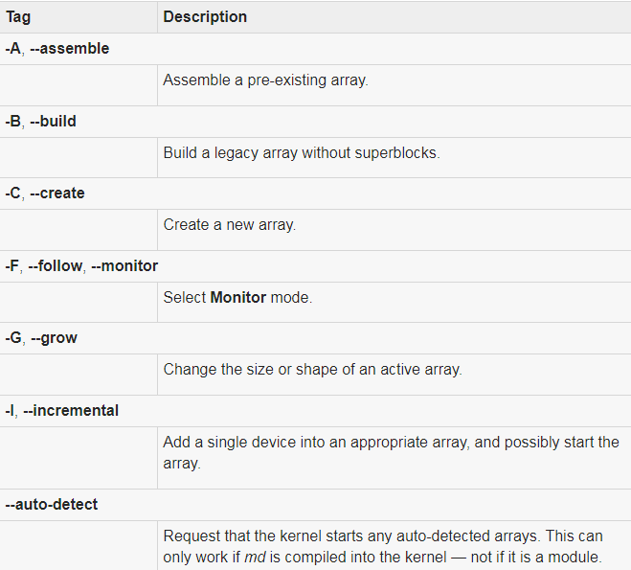
OPTIONS

Slide 24
Vi Editor with Commands
What is vi?
The vi editor is elaborated as visual editor. It is installed in every Unix system. In other words, it is available in all Linux distros.
It is user-friendly and works same on different distros and platforms. It is a very powerful application. An improved version of vi editor is vim.
The vi editor has two modes:
Command Mode: In command mode, actions are taken on the file. The vi editor starts in command mode.
Here, the typed words will act as commands in vi editor. To pass a command, you need to be in command mode.

Slide 25
Insert Mode: In insert mode, entered text will be inserted into the file. The Esc key will take you to the command mode from insert mode.
By default, the vi editor starts in command mode. To enter text, you have to be in insert mode, just type 'i' and you'll be in insert mode. Although, after typing i nothing will appear on the screen but you'll be in insert mode. Now you can type anything.
To exit from insert mode press Esc key, you'll be directed to command mode.
If you are not sure which mode you are in, press Esc key twice and you'll be in command mode.

Slide 26
Using vi
The vi editor tool is an interactive tool as it displays changes made in the file on the screen while you edit the file.
In vi editor you can insert, edit or remove a word as cursor moves throughout the file.
Commands are specified for each function like to delete it's x or dd.
The vi editor is case-sensitive. For example, p allows you to paste after the current line while P allows you to paste before the current line.
vi syntax:
vi <fileName>

Slide 27
In the terminal when you'll type vi command with a file name, the terminal will get clear and content of the file will be displayed.
If there is no such file, then a new file will be created and once completed file will be saved with the mentioned file name.
Linux vi example
Let's understand vi through an example:
To start vi open your terminal and type vi command followed by file name.
If your file is in some other directory, you can specify the file path. And if in case, your file doesn't exist, it will create a new file with the specified name at the given location.

Slide 28
Example:
vi /home/sssit/Downloads/file.txt
Look at the above snapshot, we are creating a new file file.txt (as this file doesn't exist) and have entered the full path for the directory Downloads.
Command mode
This is what you'll see when you'll press enter after the above command.
If you'll start typing, nothing will appear as you are in command mode. By default vi opens in command mode.

Slide 29
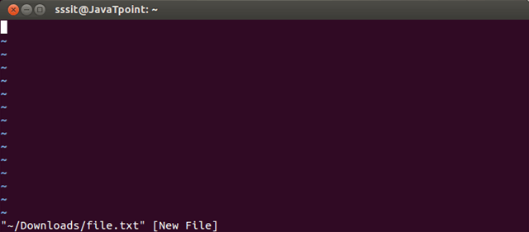
Look at the above snapshot, it is blank as it is a new file. To start typing, you have to move to the insert mode.
At the end of the terminal window, directory name and file name are displayed.

Slide 30
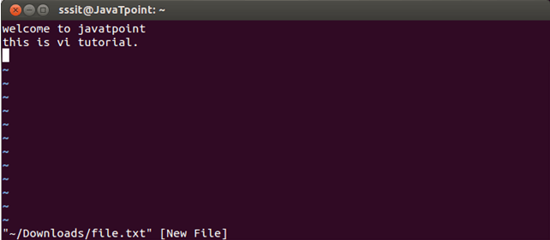
Insert mode
To move to the insert mode press i. Although, there are other commands also to move to insert mode which we'll study in next page.
Look at the above snapshot, after pressing i we have entered into insert mode. Now we can write anything. To move to the next line press enter.
Once you have done with your typing, press esc key to return to the command mode.

Slide 31
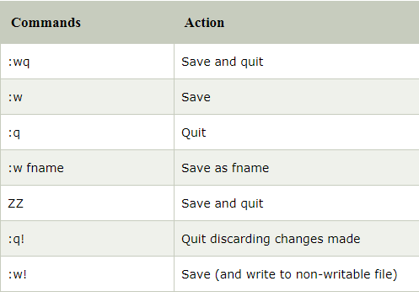
To save and quit
You can save and quit vi editor from command mode. Before writing save or quit command you have to press colon (:). Colon allows you to give instructions to vi.
exit vi table:

Slide 32
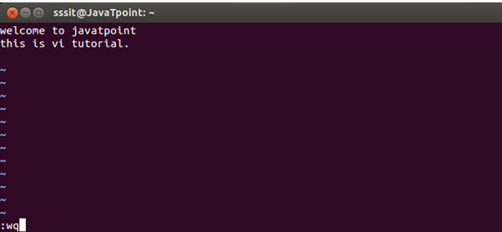
To exit from vi, first ensure that you are in command mode. Now, type :wq and press enter. It will save and quit vi.
Type :wq to save and exit the file.
Look at the above snapshot, command :wq will save and quit the vi editor. When you'll type it in command mode, it will automatically come at bottom left corner.

Slide 33
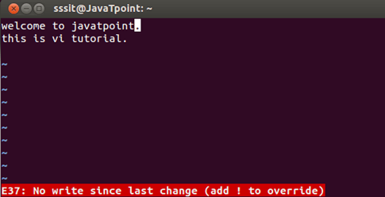
If you want to quit without saving the file, use :q. This command will only work when you have not made any changes in the file.
Look at the above snapshot, this file is modified and hence on typing :q it displays this message at bottom left corner.
The above file can be saved with the command :!q. It discards the changes made in the file and save it.

Slide 34
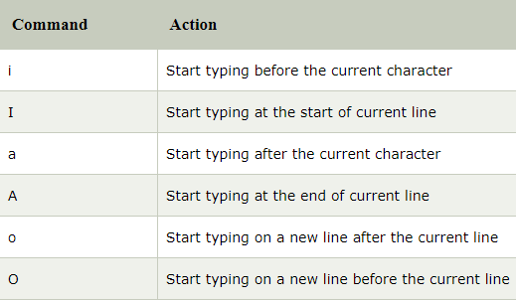
Vi Commands
Linux vi editor is different from other editors. You have to use different keys to use different functions. Although, it's quite easy and interesting to use vi editor.
The vi editor commands are case sensitive.
To switch from command to insert mode:

Slide 35
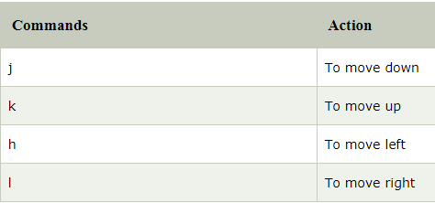
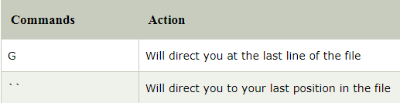
To move around a file:
To jump lines:

Slide 36
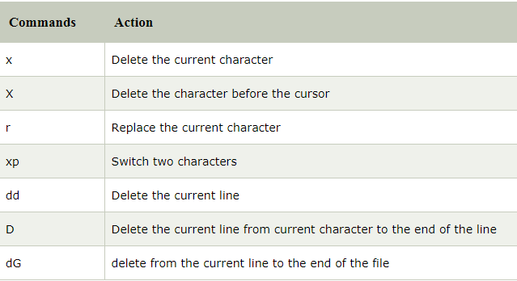
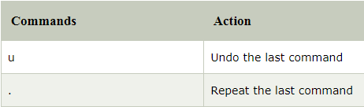
To delete:
To repeat and undo:

Slide 37
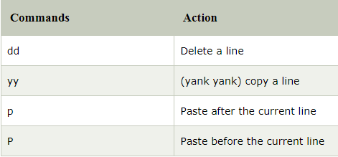
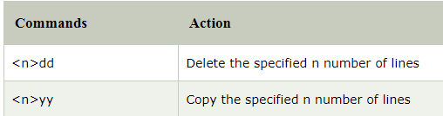
Command to cut, copy and paste:
Command to cut, copy and paste in blocks:

Slide 38
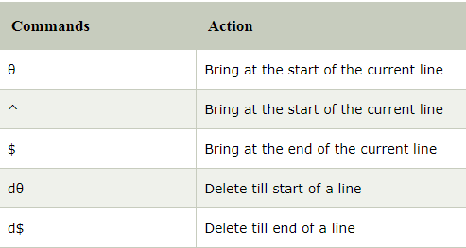
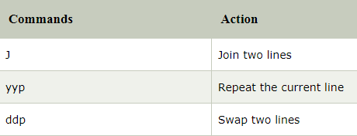
Start and end of line:
Joining lines:

Slide 39
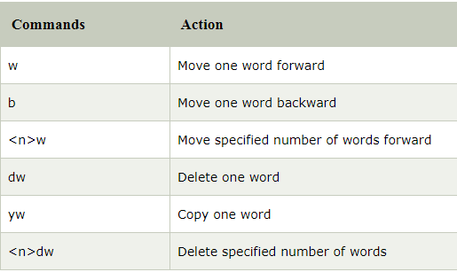
Move forward or backward:

Slide 40
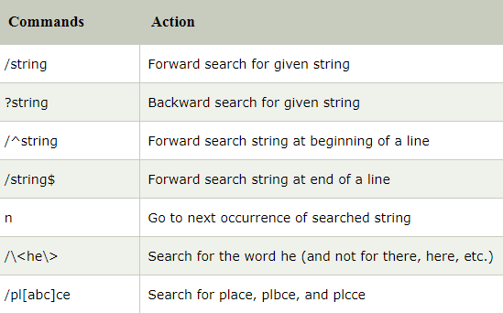
Search a string:

Slide 41
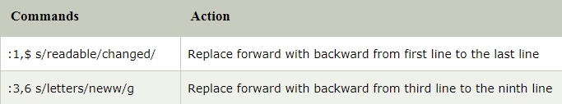
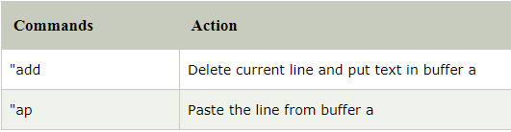
Replace all
Syntax:
:<startLine,endLine> s/<oldString>/<newString>/g
Example:
Text buffers:

Slide 42
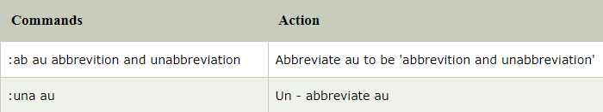
Abbreviation
Syntax:
:ab <abbreviation> <abbreviatedWord>
Example:

Slide 43
Nano Editor
GNU nano is a friendly and convenient text editor like vi and emac.
It offers many other extra features like word searching, replacing, jump to a line or column, filename tab completion, auto-indentation, etc.
Nano is a clone of the pico text editor. Nano is not pre-installed in all distros, but Ubuntu has it.
Syntax:
nano

Slide 44
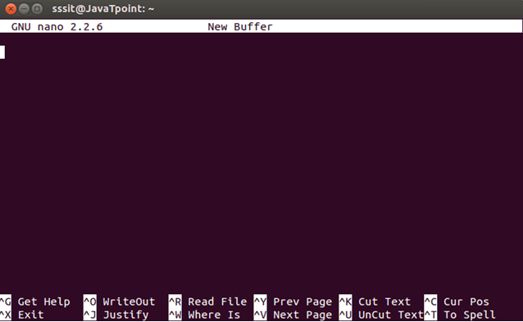

Slide 45
Look at the above snapshot, this is the default nano screen on passing command "nano".
At the top, GNU nano version is shown at the left and in the middle filename is shown being edited (currently no file is being edited hence New Buffer is written).
At the end of the screen, keyboard commands are given. Command written as ^G means press ctrl + g key and command M-R means press alt + r.
There is no use of uppercase letter in any of the keyboard command in nano editor. You can use lowercase letter with ctrl and alt keys.
Note:For MAC users escape key is used instead of alt key.
Press ctrl + g for the help menu. You'll get all information about nano editor in this menu.

Slide 46
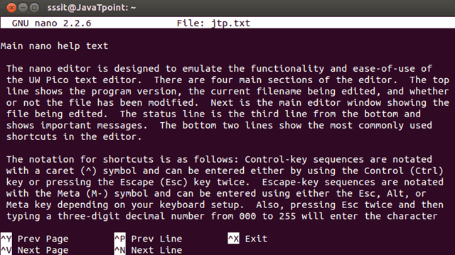

Slide 47
SSH Linux | Linux ssh command
In Linux, ssh is a protocol, which stands for Secure Shell or Secure Socket Shell.
The secure shell is useful for security while connecting to a remote server.
The ssh command uses a ssh protocol, which is a secure protocol, as the data transfer between the client and the host takes place in encrypted form.
It transfers the input through the client to the host and returns the output transferred by the host.
It executes through TCP/IP port 22.
The encrypted connection is also used to run the commands on a Linux server, port forwarding, tunnelling, and more.

Slide 48
There are lots of SSH clients that are available for both commercial and free.
The OpenSSH is its most widely used client.
It is available for all the most used platforms such as Windows, Linux, macOS, OpenBSD, and more.
Syntax:
ssh user_name@host(IP/Domain_name)

Slide 49
Components of ssh command
The ssh command consists of three different types of components:
ssh command: It instructs the machine to create a secure encrypted connection with the host system.
User name: User name is the name of the Linux user, which is being accessed by the host machine.
Host: A host is a machine that is being accessed by the user, such as a computer or a router. A domain name or an IP address also refers as Host.

Slide 50
How SSH works?
To establish an SSH connection, we need two primary components; a client and a host, which can be a server, domain name, IP address, and more.
Also, we require a ssh client to connect with another computer or server.
The client uses the specified host information to establish the connection; if the provided credential verified, it will establish an encrypted connection.

Slide 51
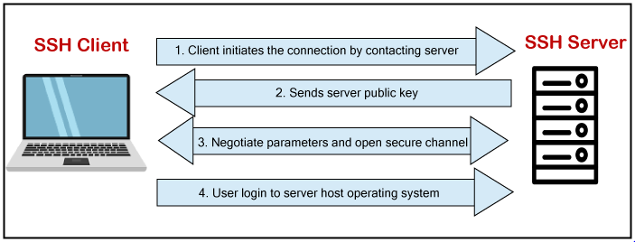
The server (Host) contains an SSH process that is ready to take a request for the client connection through a TCP/IP port.
Once the client initiates a connection, the host responds with the necessary information and exchanges the credentials.

Slide 52
If the provided information is verified, the SSH protocol establishes a new connection for the available environment.
The default SSH protocol version for SSH server and SSH client communication is version 2

Slide 53
Install OpenSSH client on Linux (Ubuntu)
The OpenSSH client is a connectivity tool for the systems to connect two systems with the ssh protocol.
It is also called as ssh and can be invoked from the Linux terminal.
This client package contains other SSH utilities like sftp, scp, and ssh that are installed by default with the ssh command.
It performs remote operations using these ssh utilities.
The OpenSSH client comes preinstalled with most Linux distributions. If any Linux system does not have the ssh client, we can install it manually by using the package manager.

Slide 54
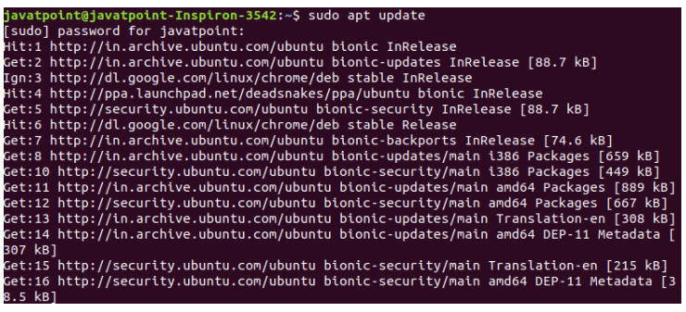
To install the OpenSSH client, execute the below command:
sudo apt update
The above sudo command will update the package of the Linux system. Consider the below snap of the output:

Slide 55
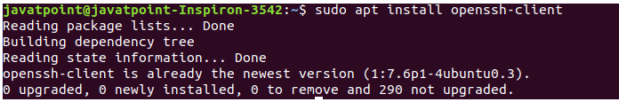

After updating the Linux system, execute the below command to install the OpenSSH client:
sudo apt install OpenSSH-client
The above command will install the latest package of the OpenSSH client. Consider the below output:
As we can see from the above output, a daemon process is running to install the OpenSSH client. As in our machine, OpenSSH client is already installed, so it has displayed the message 'openssh-client is already the newest version.‘

Slide 56
Install OpenSSH server on Linux(Ubuntu)
To make an SSH connection, we need to have the server-side part of the SSH software in our machine.
To check the installation status of the server, open the terminal and execute the below command:
ssh localhost
If our machine does not have the server tool kit of the OpenSSH client, then it will display the output as follows:
In the above case, we have to install the OpenSSH server.

Slide 57
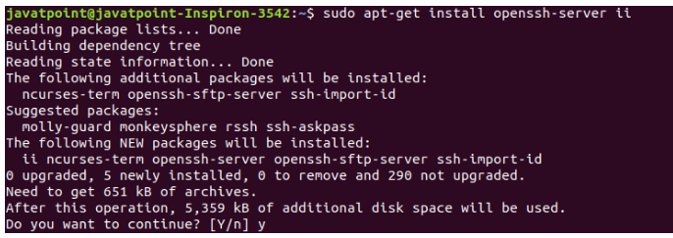
To install the SSH server, execute the below command:
sudo apt-get install openssh-server ii
The above command will prompt for the system administrative password, type the password, and press ENTER key to start the installation process. Next, it will confirm the installation type 'y' key and press ENTER key. Consider the below output:

Slide 58
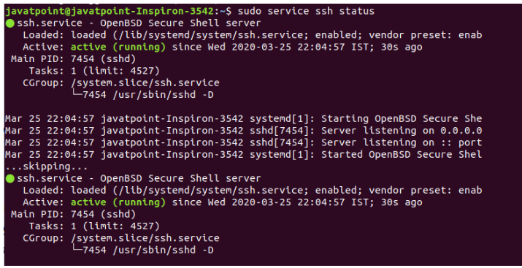
To verify the installation, execute the below command:
sudo service ssh status
The above command will display the status of the installation. If the installation is successful, it will display the output as follows:

Slide 59
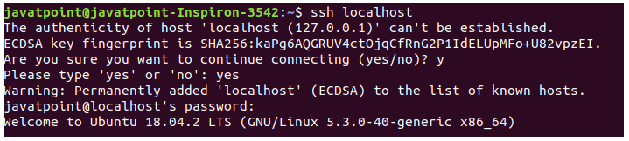
There is another way to test the installation by ssh localhost command:
ssh localhost
The above command will verify the connectivity type 'yes' to continue.
Consider the below output:
Now, we have successfully installed the OpenSSH server on our machine.

Slide 60
SSH Key Generation
To create a connection with the host client, we need a specific key for an encrypted connection.
Logging in to remote host computer by ssh key is more secure than using a password.
After logging in the host, computer commands will only work if these commands will be written to the host computer directly.
To generate the ssh key, execute the below command:
ssh-keygen
The above command will generate the public and private keys for creating a connection to the host system. Consider the below output:

Slide 61
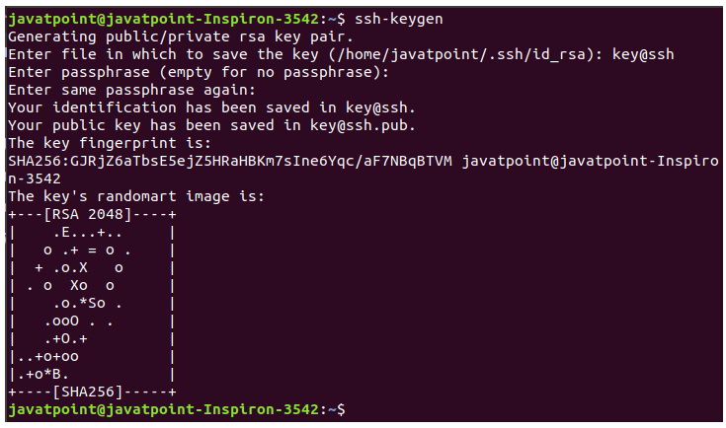
Consider the below output:
we can see from the above output, the ssh keys have generated. The ssh-keygen command creates two files, key@ssh, and key@ssh.pub, which contain private and public key, respectively.
It is recommended to hide the private key for security purposes, copy the public key to the remote host. After copying this key to a remote host, we can establish a connection using the SSH key, not by the password.

Slide 62
we can see from the above output, the ssh keys have generated.
The ssh-keygen command creates two files, key@ssh, and key@ssh.pub, which contain private and public key, respectively.
It is recommended to hide the private key for security purposes, copy the public key to the remote host.
After copying this key to a remote host, we can establish a connection using the SSH key, not by the password.

Slide 63
Techniques of SSH Protocol
The SSH protocol is more secure as compared to other protocols such as telnet, and the encryption techniques are quite good than other protocols. There are three major encryption techniques which are used by the SSH. They are as following:
Hashing: Hashing is an authentication technique that is used to ensure whether the received data is coming from a genuine sender and is unaltered or not. It uses a hash function to generate a hash code from the received data. However, it is not possible to regenerate the data from the hash value. This hash value is verified at the sender's, and receiver's both ends. If it matches, the data is authenticated.
Symmetrical encryption: This technique generates a single key for encryption as well as decryption. The generated key is distributed among the hosts and clients and creates a secure connection. It is the most basic encryption technique. It performs its best when the data is encrypted and decrypted on the same machine.
Asymmetric encryption: The asymmetric encryption technique is considered as more secure than other technologies, as it uses the ssh keys (Public and private keys) for encryption. The public key is distributed to other machines to create a secure connection, while the private key only used by the client machine. The secure connection is established by both the public and private keys.

Slide 64
SSH Commands
The client ssh has many functions for the ssh command, such as creating a key, configuring a key, opening an SSH server, holding a key for single sign-on, file transfer client, and more. Some most useful ssh commands are as follows:
ssh-keygen: It is used to create a key pair for establishing a connection and public key authentication.
ssh-copy-id: It is used to configure a public key as a valid user on a server.
ssh-agent: It is used to create an agent to hold private key for single sign-on.
ssh-add: It is a tool to add a key to the agent.
scp: It is a file transfer client that provides an RCP-like command-line interface.
sftp: It is a file transfer command that provides an FTP-like command-line interface.
sshd: It is an OpenSSH server for the Linux system.

Slide 65
Options: There are many command-line options are available to specify the different specification of SSH output. Some useful options are as following:
-c: It is used to specify query class for non-IN data.
-C: It is used to compare SOA records on authoritative nameservers.
-d: This option is considered as equivalent to -v.
-i: It is used for IP6.INT reverse lookups.
-l: It is used to list all hosts in a domain using AXFR.
-m: This option sets the memory debugging flag, such as trace|record|usage.
-N: It is used to change the number of dots allowed before root lookup is done.
-r: It is used to disable recursive processing.
-R: It specifies the number of retries for UDP packets.
-s: It is used for a SERVFAIL response should stop query.
-t: It is used to specify the query type.
-T: It is used to enable the TCP/IP model.
-v: It is used for verbose output.
-V: It is used to print the version number and exit.
-w: It is used to specify the wait forever for a reply.
-W: It is used to specify how long to wait for a reply.
-4: It is used only for IPv4 query transport.
-6: It is used only for IPv6 query transport.

Slide 66
How to connect via SSH
As we have installed the SSH client and server, we can establish a secure connection with other machines.
For a secure connection between two machines, they both have ssh client and server installed.
To establish a connection, execute the below command:
ssh your_username@host_ip_address
If the user name is verified by the machine that you want to connect, execute the below command:
ssh host_ip_address
The above command will ask for the password, type the password, and press ENTER key.

Slide 67
If we are making a connection for the first time, it will ask for the continue connecting; type yes and press Enter.
It will add an ECDSA (Elliptical curve Digital Signature Algorithm) key and connect you to a remote server.
You are now eligible to control and manage a remote machine by your terminal.
If you face any difficulty in establishing a connection, consider the following points:
If the provided IP address of the remote machine is valid.
The port SSH daemon is listening to is not blocked by a firewall or forwarded incorrectly.
The username and password that you entered are correct.
SSH software is installed properly.

Slide 68
What is BIG DATA? Introduction, Types, Characteristics, Example
What is Data?
What is Big Data?
Examples Of Big Data
Types Of Big Data
Characteristics Of Big Data
Advantages Of Big Data Processing

Slide 69
What is Data?
The quantities, characters, or symbols on which operations are performed by a computer, which may be stored and transmitted in the form of electrical signals and recorded on magnetic, optical, or mechanical recording media.
What is Big Data?
Big Data is a collection of data that is huge in volume, yet growing exponentially with time.
It is a data with so large size and complexity that none of traditional data management tools can store it or process it efficiently.
Big data is also a data but with huge size.

Slide 70


Following are some of the Big Data examples-
The New York Stock Exchange generates about one terabyte of new trade data per day.
Social Media
The statistic shows that 500+terabytes of new data get ingested into the databases of social media site Facebook, every day. This data is mainly generated in terms of photo and video uploads, message exchanges, putting comments etc.

Slide 71

A single Jet engine can generate 10+terabytes of data in 30 minutes of flight time.
With many thousand flights per day, generation of data reaches up to many Petabytes.

Slide 72
Types Of Big Data
Following are the types of Big Data:
Structured
Unstructured
Semi-structured

Slide 73
Structured
Any data that can be stored, accessed and processed in the form of fixed format is termed as a 'structured' data.
Over the period of time, talent in computer science has achieved greater success in developing techniques for working with such kind of data (where the format is well known in advance) and also deriving value out of it.
However, nowadays, we are foreseeing issues when a size of such data grows to a huge extent, typical sizes are being in the rage of multiple zettabytes.

Slide 74
Do you know?
10²¹ bytes equal to 1 zettabyte or one billion terabytes forms a zettabyte.
Looking at these figures one can easily understand why the name Big Data is given and imagine the challenges involved in its storage and processing.
Do you know?
Data stored in a relational database management system is one example of a 'structured' data.

Slide 75
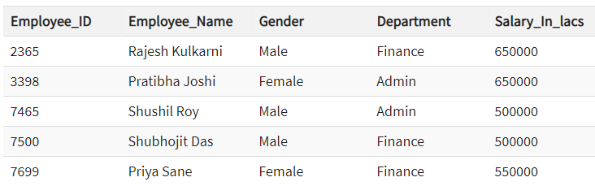
Examples Of Structured Data

Slide 76
Unstructured
Any data with unknown form or the structure is classified as unstructured data.
In addition to the size being huge, un-structured data poses multiple challenges in terms of its processing for deriving value out of it.
A typical example of unstructured data is a heterogeneous data source containing a combination of simple text files, images, videos etc.
Now day organizations have wealth of data available with them but unfortunately, they don't know how to derive value out of it since this data is in its raw form or unstructured format.

Slide 77

Examples Of Un-structured Data
The output returned by 'Google Search'

Slide 78
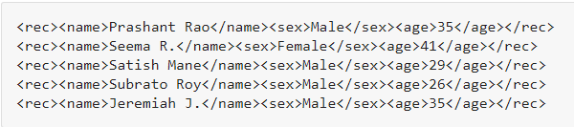
Semi-structured
Semi-structured data can contain both the forms of data. We can see semi-structured data as a structured in form but it is actually not defined with e.g. a table definition in relational DBMS.
Example of semi-structured data is a data represented in an XML file.
Examples Of Semi-structured Data
Personal data stored in an XML file-

Slide 79
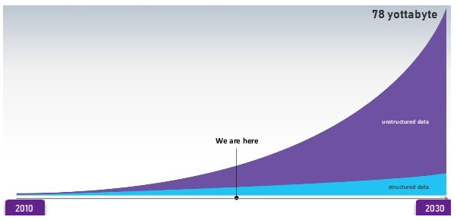
Data Growth over the years:
Please note that web application data, which is unstructured, consists of log files, transaction history files etc.
OLTP systems are built to work with structured data wherein data is stored in relations (tables).

Slide 80
Characteristics Of Big Data
Big data can be described by the following characteristics:
Volume
Variety
Velocity
Variability

Slide 81
Volume – The name Big Data itself is related to a size which is enormous. Size of data plays a very crucial role in determining value out of data.
Also, whether a particular data can actually be considered as a Big Data or not, is dependent upon the volume of data. Hence, 'Volume' is one characteristic which needs to be considered while dealing with Big Data.
(ii) Variety – The next aspect of Big Data is its variety.
Variety refers to heterogeneous sources and the nature of data, both structured and unstructured. During earlier days, spreadsheets and databases were the only sources of data considered by most of the applications.
Nowadays, data in the form of emails, photos, videos, monitoring devices, PDFs, audio, etc. are also being considered in the analysis applications. This variety of unstructured data poses certain issues for storage, mining and analyzing data.

Slide 82
(iii) Velocity – The term 'velocity' refers to the speed of generation of data.
How fast the data is generated and processed to meet the demands, determines real potential in the data.
Big Data Velocity deals with the speed at which data flows in from sources like business processes, application logs, networks, and social media sites, sensors, Mobile devices, etc.
The flow of data is massive and continuous.
(iv) Variability – This refers to the inconsistency which can be shown by the data at times, thus hampering the process of being able to handle and manage the data effectively.

Slide 83
Benefits of Big Data Processing
Ability to process Big Data brings in multiple benefits, such as-
Businesses can utilize outside intelligence while taking decisions
Access to social data from search engines and sites like facebook, twitter are enabling organizations to fine tune their business strategies.
Improved customer service

Slide 84
Traditional customer feedback systems are getting replaced by new systems designed with Big Data technologies.
In these new systems, Big Data and natural language processing technologies are being used to read and evaluate consumer responses.
Early identification of risk to the product/services, if any
Better operational efficiency
Big Data technologies can be used for creating a staging area or landing zone for new data before identifying what data should be moved to the data warehouse.
In addition, such integration of Big Data technologies and data warehouse helps an organization to offload infrequently accessed data.

Slide 85
Summary
Big Data definition : Big Data is defined as data that is huge in size. Bigdata is a term used to describe a collection of data that is huge in size and yet growing exponentially with time.
Big Data analytics examples includes stock exchanges, social media sites, jet engines, etc.
Big Data could be 1) Structured, 2) Unstructured, 3) Semi-structured
Volume, Variety, Velocity, and Variability are few Big Data characteristics
Improved customer service, better operational efficiency, Better Decision Making are few advantages of Bigdata

Slide 86
End of Session Q & A

